Slide 1


Screen Time and Health Outcomes in Youth
DSC 680 - Applied Data Science
Professor Amirfarrokh Iranitalab
Project 3 Milestone 3
By Gabriel Vance
March 2026

Slide 2
Background / Context
Youth screen exposure now spans smartphones, social media, streaming, gaming, and school apps.
Prior research shows mixed effect sizes, but repeated concerns involve sleep loss, emotional strain, and attention burden.
This study examines whether heavier daily screen use is associated with poorer health and behavioral outcomes.

Slide 3
Business Problem and Objective
Goal: identify whether higher daily screen time is linked to sleep, mental-health, attention, and cognitive risk.
Question 1: Is total screen exposure associated with poorer sleep and worse mental-health burden?
Question 2: Which usage patterns and subgroups show the strongest adjusted risk?
Outcome: support evidence-based thresholds and targeted interventions, not causal claims.

Slide 4
Data Sources and Preparation
Draft analysis uses a harmonized pilot dataset with 2,400 youth-level records.
Core fields: total/subtype screen hours, age, sex, SES, physical activity, sleep, anxiety, depression, attention, cognition.
Preparation: range checks, duplicate review, and median imputation for low-rate missingness.
Derived measures: mental-health index, poor-sleep flag, and heavy-screen exposure indicator.

Slide 5
Study Sample and Schema
All time variables were standardized to hours per day.
Key age groups:
- 10-12
- 13-15
- 16-18
Thresholds: heavy use >=6 hours/day; poor sleep <7.5 hours/night.

Slide 6
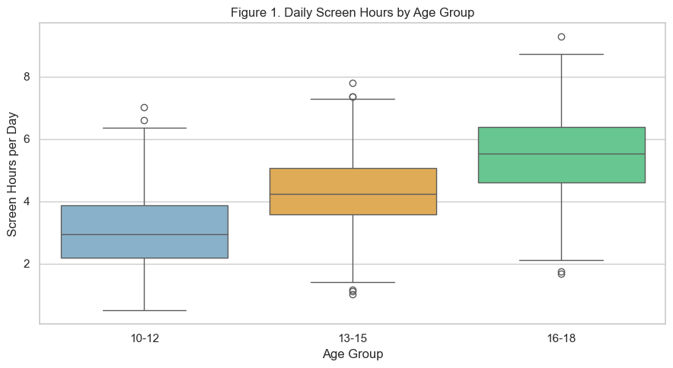
Age-Level Screen Exposure Patterns
Figure 1 summarizes daily screen hours by age group.
Mean exposure rises from about 2.99 hours (10-12) to 4.31 (13-15) to 5.52 (16-18).
Older youth show a clear upward shift in exposure and more high-use cases.
Result: screen burden is concentrated most heavily in the oldest age band.

Slide 7
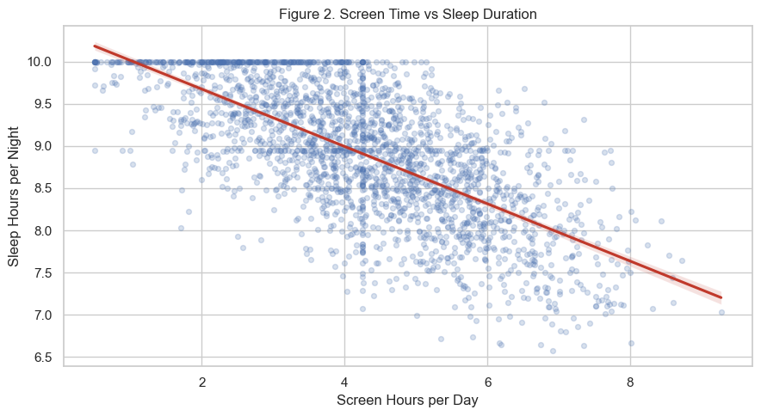
Screen Time, Sleep, and Outcomes
Figure 2 shows a strong negative relationship between screen hours and sleep duration.
Correlations: screen vs sleep r = -0.683; screen vs attention r = -0.553.
Screen exposure is positively associated with worse mental-health burden (r = 0.748).
Interpretation: higher screen use aligns with less sleep and weaker behavioral outcomes.

Slide 8
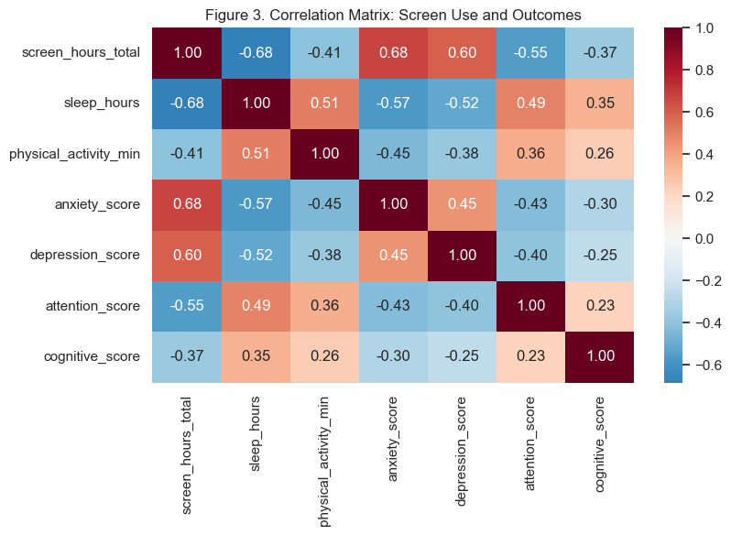
Adjusted Models and Key Estimates
Models estimated:
- OLS for mental-health index
- Logistic regression for poor sleep risk
Controls: age, sex, SES, physical activity, and sleep where appropriate.
Key estimates: OR = 2.256 for poor sleep; OLS beta = 0.213 for mental-health burden.

Slide 9
Practical Implications and Uses
Findings support targeted intervention rather than one-size screen restrictions.
Potential uses:
- School sleep-risk and distress dashboards
- Family guidance focused on behavior patterns, not only total hours
- Scenario planning that combines sleep hygiene, activity, and screen routines
Communication should emphasize uncertainty and supportive framing.
These results are useful for policy discussion, not deterministic labeling.

Slide 10
Key Findings Summary
Average daily screen exposure: 4.26 hours.
Average sleep duration: 8.91 hours.
Heavy-use prevalence: 13.5%;
poor-sleep prevalence: 4.9%.
Higher screen time remained associated with worse sleep and mental-health burden after adjustment.

Slide 11
Conclusions
Heavier screen exposure is associated with poorer sleep and greater mental-health burden.
Effect magnitudes are large enough to matter for parents, schools, and public-health planning.
The pilot workflow is reproducible and ready for extension to final merged Kaggle data.
Best use: targeted intervention planning, not deterministic prediction or blame.

Slide 12
Limitations and Responsible Use
Findings are association-based and do not establish causality.
The structure is cross-sectional and relies on self-reported behavior proxies.
Source harmonization, missingness, and subgroup reporting bias remain key challenges.
Responsible use requires de-identification, subgroup-safe reporting, and non-stigmatizing interpretation.

Slide 13
References
References from the milestone report:
1. CDC (2025) on screen time and adolescent health outcomes
2. Orben and Przybylski (2019)
3. Twenge and Campbell (2018)
4. Walsh et al. (2018); WHO (2019); AAP (2025)

